Slide 1
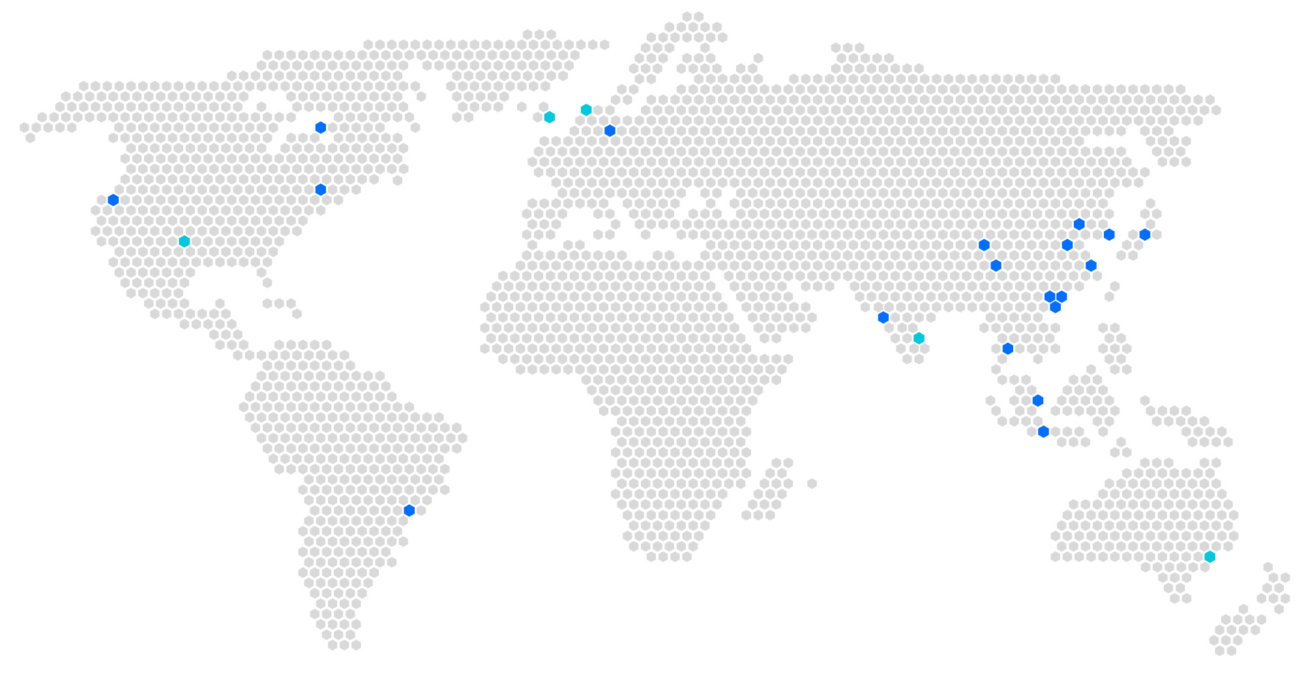
Global Cloud Infrastructure
1 Toronto
1 Amsterdam
1 London
2 Silicon Valley
2 Frankfurt
12 Beijing
2 Chengdu
3 Nanjing
2 Seoul
2 Virginia
2 Tokyo
1 Dallas
2 Chongqing
11 Shanghai
7 Guangzhou
3 Shenzhen
2 Mumbai
3 Hong Kong
1 Chennai
2 Bangkok
4 Singapore
26
2 Jakarta
Regions
1 Sao Paulo
70
1 Sydney
Online
Partnerships
Availability zones
65
5

Slide 2
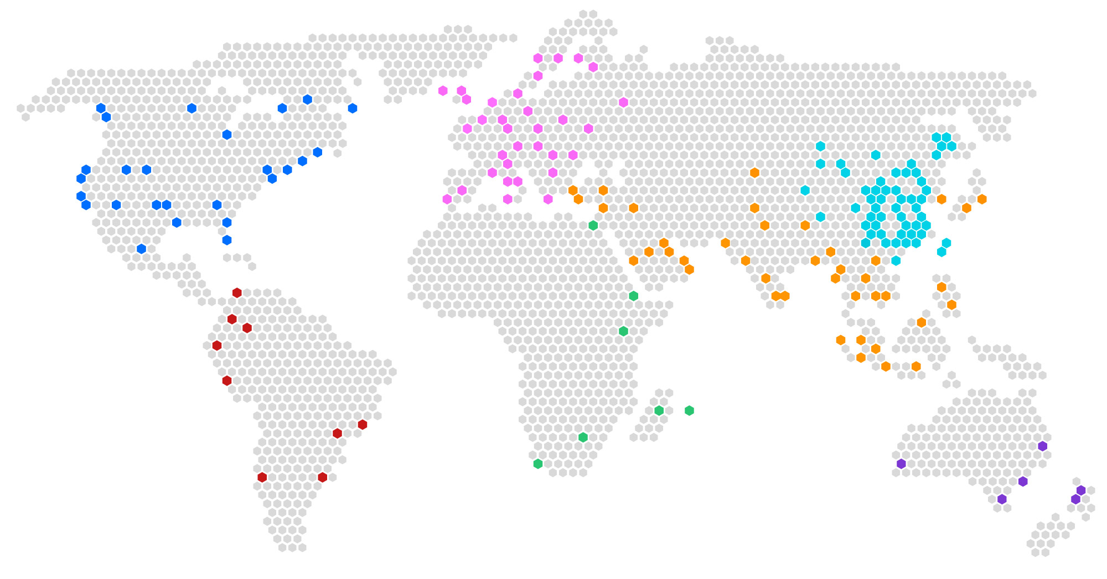
Global CDN Presence - Location of Cache Node Clusters
800+
nodes outside of Mainland China
2,000+
2,800⁺
70⁺
160Tbps⁺
nodes in Mainland China
Acceleration nodes
Countries
Bandwidth

Slide 3
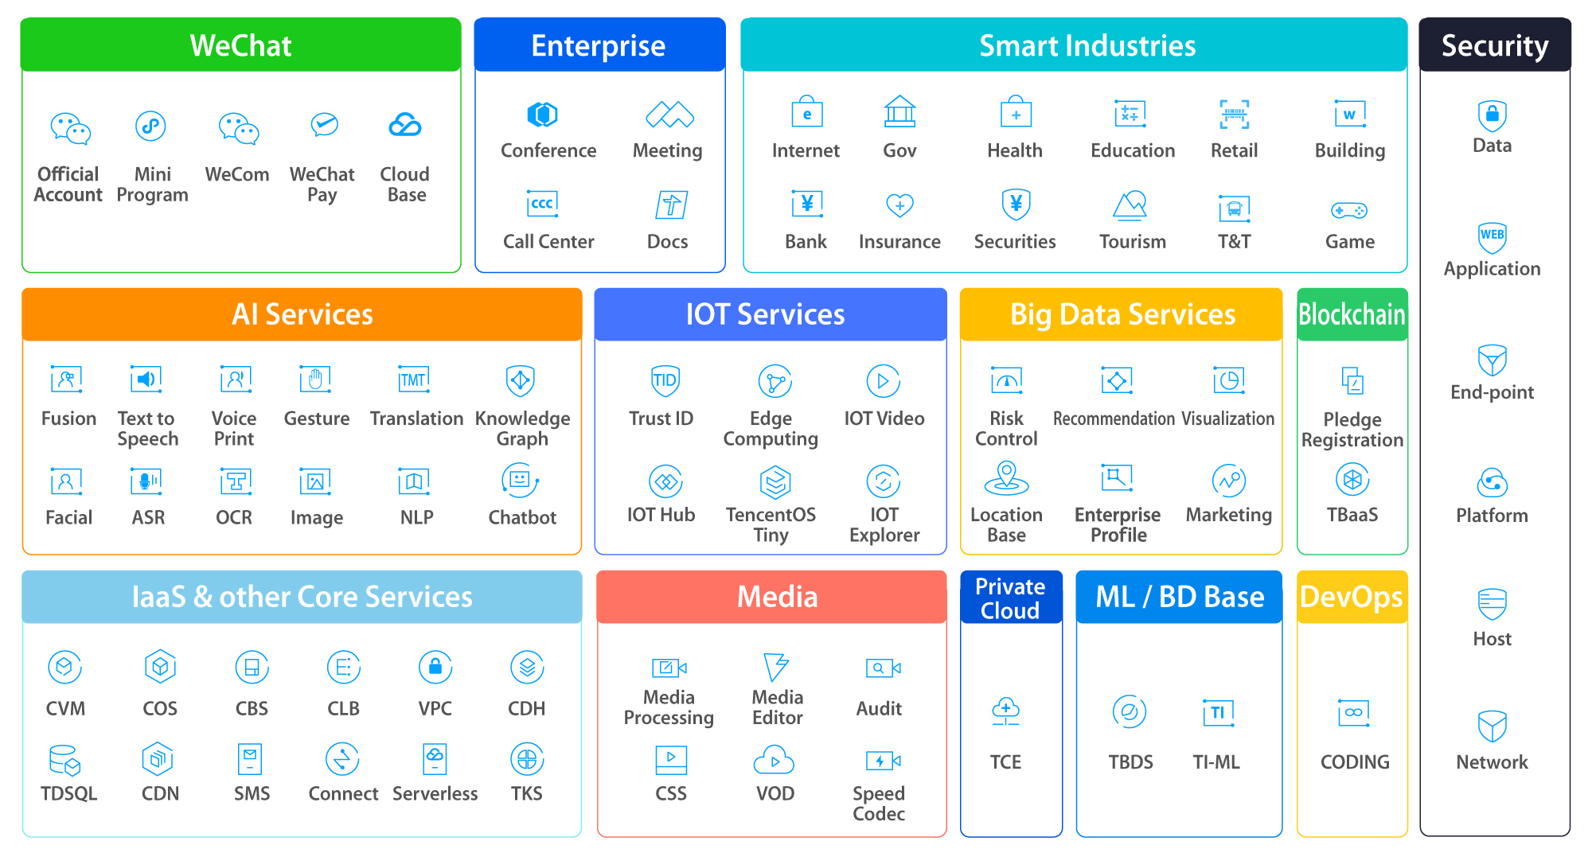
Tencent Cloud Offerings
Solutions & SaaS
Specialized PaaS
Services

Slide 4
Tencent Cloud
Video on Demand
Product Briefing

Slide 5
Product Overview
Business Challenges
Feature Briefing
Scenario Solutions
Customer Cases
Contents
Notes:
The content includes the following 5 parts，which are：
Overview about the product
Common business challenges
Brief introduction to core features
Solutions for some common scenarios
Product Architecture
Success customer cases.

Slide 6
Product Overview
Video on Demand (VOD) provides one-stop Video PaaS solutions for media upload, storage, processing and distribution. VOD provides scenario-based solutions and best practices in multimedia industry.
Transcoding
Watermark
Screenshot
Encryption
Live Record
Client Upload
Server Upload
Accelerated Distribution
Access Control
Bandwidth Limitation
File Storage
Media Asset Management
Quality monitoring
Super player
Media Upload
Cloud Storage
Media Process
Distribution
Playback
AI audit
AI recognition
AI analysis
Full-link support: Uploading, Storage, Media Asset Management, Media Processing, Accelerated Distribution and Media Player
Scenario-based solutions covering Online Education, E-Commerce, Entertainment, etc.
Notes:
First, let’s look at product overview.
As you can see on this page, vod is an end to end paas solution for media industry, which support full-link capabilities such as Uploading, Storage, Media Asset Management, Media Processing, Accelerated Distribution and Media Player.
For upload, we provide server/client upload sdk which can let users create videos, live recording, and upload acceleration ,which can improve the upload success rate in poor network condition.
And then storage, we have media management and multi level labels, also we have great feature like smart cold storage to help reduce the storage cost.
For media processing, we have TSC transcoding which is the best in the industry, and also we have DRM solution which prevent stealing and provide copyright protection, as well as Video AI features
for media distribution, with vod cdn acceleration. And advanced features like access control and bandwidth limitation.
And for media playback, we have multi terminal super player sdk, support all client platforms, together with video encryption and quality monitoring.
We also cover a wide range of business scenarios like Online Education, E-Commerce, Entertainment and so on.

Slide 7
Business Challenges
Industry Pain Points
VOD Core Competences
Quality Issues
Playback quality, upload quality, etc.
High Cost
Storage, transcoding, distribution, etc.
Security Problems
Hotlinking and piracy
Need of Advanced Features
Media searching, tagging, transcoding, etc.
High Quality
End-to-end optimized quality
Low Cost
Reduce storage, distribution and transcoding cost
High Security
Anti-leech and DRM protection
Rich Features
Scenario-based solution
Tencent VOD has absolute advantage over similar VOD products, and tackles industry pain points effectively.
Notes:
Next, let’s look at business challenges. In media industry, we often face the following pain points such as Quality Issues, High Cost, Security problems, Need of Advanced Features.
For Quality issues like Play Caton，and upload performance. We can provide High quality through End-to-end network and protocol optimized quality.
For Hight cost, like Storage,transcoding and distribution, we can lower cost by reduce storage, distribution cost through core transcoding functions.
We also provide high security by anti-leech and DRM protection.
We have a range of abilities to meet advanced features requirements such as media searching, tagging and scenario-based solutions.
In conclusion, tencent vod has absolute advantage over similar vod products and tackles industry pain points effectively.

Slide 8
Multiple Upload Approaches with High Quality
Upload from Client
Upload from Server
iOS, Android, Web and WeChat Mini Program SDK etc.
Java, C#, PHP, Python, Node.JS and Go SDK etc.
Pull Upload
Live Stream Record
Batch upload media files from URLs via console or API
Record live streaming content to VOD storage
Competitive Advantages
Flexible Approaches
Upload from Console, Client, Server and Third-party URLs
Record Live Stream to VOD
Full-Terminal SDK
SDK for all platforms including iOS, Android, Web and WeChat Mini Program
Stability and Reliability
Market-leading UGC Upload solution with recognized quality
Notes:
As you can see, Here is our upload capabilities, a core function, we can provide multiple upload approaches with high quality includes upload from client or server, and also support fully terminal and multi language sdk to help reduce access costs.
Our vod products have competitive advantages：like flexible approaches support upload from console, client, server and third-party URLS, as well as record live stream to vod We also provide full-terminal sdk capabilities for all platforms including ios, android, web and wechat mini program
At the same time, The market-leading UGC upload solution with recognized quality ensured service stability and reliability.

Slide 9
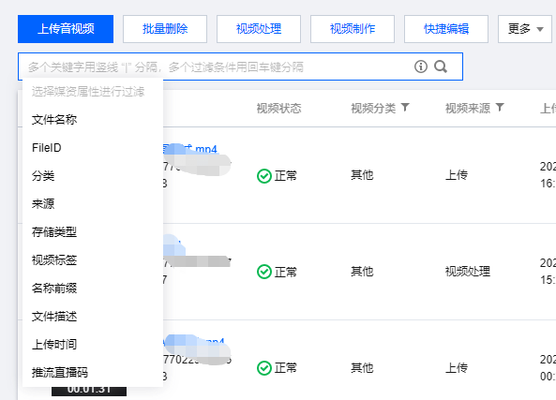
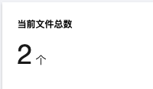
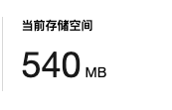
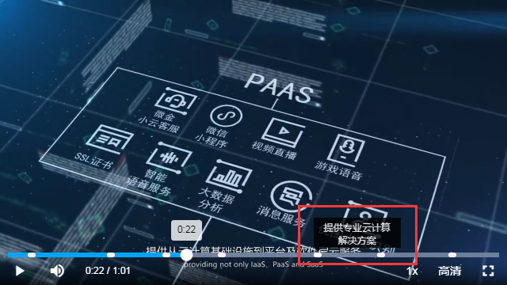
Media Asset Management: Cost-efficient & Easy to Use
More than storage: classification, tagging, key frame, searching etc.
Simple object storage solution
Only Basic Features:
Only media storage, no advanced features
Hard to Use:
Difficulty handling multi-file format media (HLS/DASH)
Multi-standard video management is complex
Media Storage: store files in different regions
Media Search: look up files by name, type, tag, source etc.
VOD Media Asset Management
Rich features：
Classification, tagging, key frame, searching features besides storage. All free!
Click to use：
Visual configuration make management much easier.
Classification: add categories/tags to videos
Key frames: show key frame information on progress bar
Notes:
As showed on this page, Media asset management is one of our core abilities, compared to
simple object storage solution that only have basic features like media storage, and difficultly handling multi-file format media like HLS/DASH, and multi-standard video management is complex.
The ability of media asset management provided by vod, In addition to standard storage capabilities like store files in different regions, also provide more than storage capbilities: classification which add categories/tags to videos to easy to manage and search,
media search which support look up files by name, type, tag, source, as well as the ability of the progress bar to display keyframes information.
So, These rich features and visual configuration capability make management for media file much easier.

Slide 10
VOD Smart Cold Storage
High
Price
Low
Smart: change storage class automatically
Set to infrequent access if viewed less than 10 times a day
Set to archive if the file has not been viewed for 90 days
Standard
Standard_IA
Archive
Deep Archive
Fast
Response
Slow
Popular Cache Files
Flexible: Customized strategies
By time: set to archive after 1 year;
By source: set record files to deep archive;
By type: set non-member files to infrequent access
Object Storage
CDN
Because of CDN caches, the origin traffic of popular files is less than the origin traffic of unpopular ones.
VOD provides unique Smart Cold Storage in industry, saving millions of storage cost for customers.
Notes:
Another core function of vod is smart cold storage, it is based on custom cold storage policies. It automatically transitions cold files to a storage class at lower costs based on the file creation time, file type, and access frequency.
it can support change storage class automatically, for instance, set to infrequent access if the media file viewed less than 10 times a day, or set to archive if the file has not been viewed for 90 days.
as shown in the picture on the right，vod has the following storage classes: STANDARD, STANDARD_IA, ARCHIVE, and DEEP ARCHIVE
From left to right, the price is getting cheaper, suitable for files with lower access frequency，and the access response speed is getting slower
VOD supports flexible smart cold storage polices and various cold storage dimensions.
The customized strategies like by time, set to archive after 1 year,by source: set record files to deep archive, by type, set non-member files to infrequent access
Many customer cases in the past have demonstrated that the smart cold ability of vod, helping customers save millions of storage cost.

Slide 11
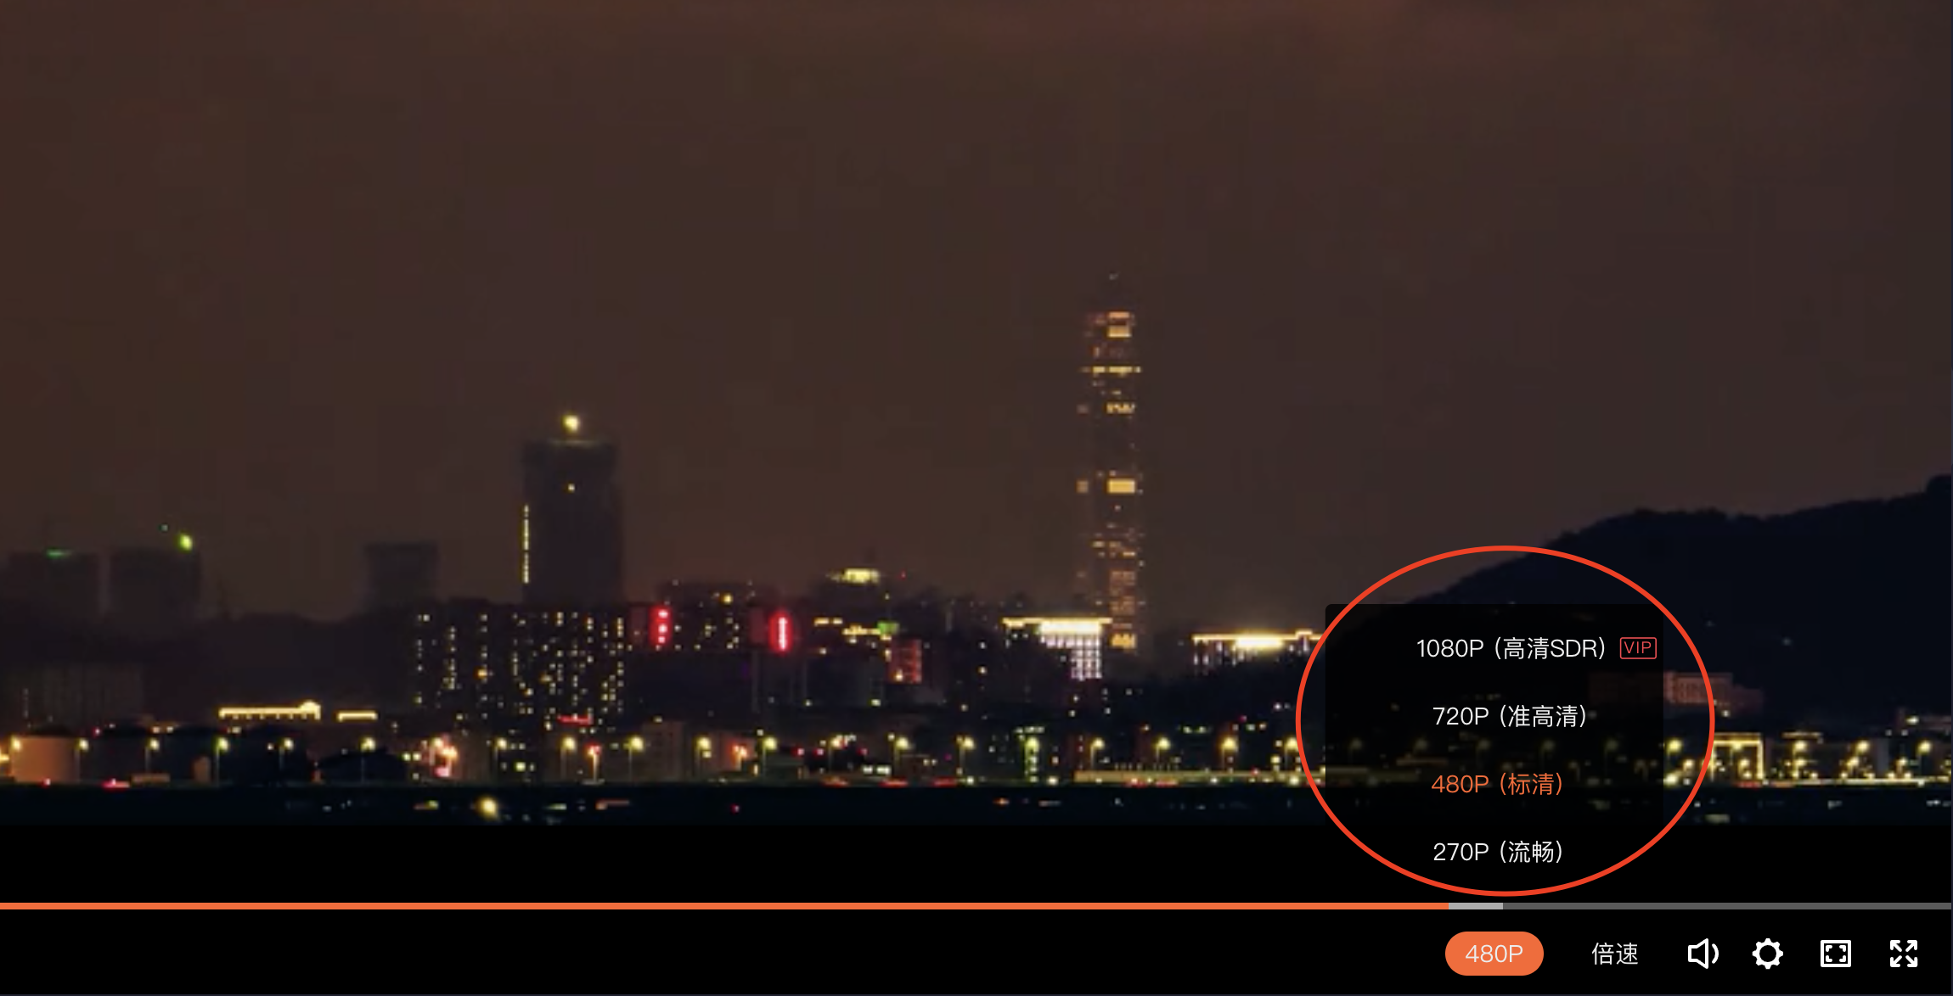
Partial Deletion: Save the storage cost
Pain Point: High storage cost of saving videos of different definitions
Use case: Delete high-definition original videos and save low-definition transcoded video to reduce storage cost.
Notes:
For on-demand scenarios, the industry faces relatively prominent pain points： High storage cost of saving videos of different definitions
In order to solve this pain point， vod provide media delete capability which involves deleting media resources stored in VOD to reduce the storage costs. also provides a rich-featured and easy-to-use media deletion service.
For an use case, it support delete high-definition original videos and save low-definition transcoded video to reduce storage cost.

Slide 12
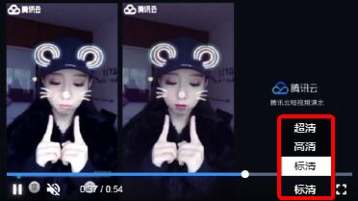
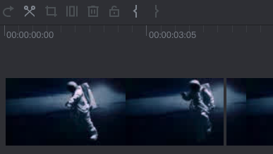
Feature-rich Media Processing with excellent quality
Providing a series of features such as transcoding, screenshots, and watermarking etc.
Transcoding supports multi resolutions output
Screenshots take thumbnails from media
Watermarking image or text at specified location
TSC Compress bitrate while maintaining high image quality
Clipping media into serveral segments
Feature-rich
Supporting dozens of media processing features
Excellent-quality
1st Place of transcoding speed, compression rate, and image quality
Intelligence cost-reducing
Leading solution of reducing traffic and storage costs
Notes:
Next, let’s see the rich media processing functions with excellent quality provided by vod.
These features include transcoding, screenshots, and watermarking
We can see this picture, transcoding supports multi resolution output, It is beneficial for different end users to watch smoothly under different network environments
look at the middle picture， the screenshots ability support take thumbnails from media, and Convenient follow-up processing
A watermark can be added to a video at specified location, it also use to mark video ownership or copyright.
VOD's Top Speed Codec (TSC) transcoding feature uses smart scenario recognition, dynamic encoding technology, and precise bitrate control model to achieve a higher subjective image quality at a lower bitrate (reduced by nearly 50%), reducing the network traffic and storage costs.
The splicing and clipping feature allows you to clip audio/video files accurately down to the millisecond and into serveral segments, and splice multiple different audio/video files into a new audio/video file.
So, With these rich features and excellent quality, vod can provide leading solutions of reducing traffic and storage costs.

Slide 13
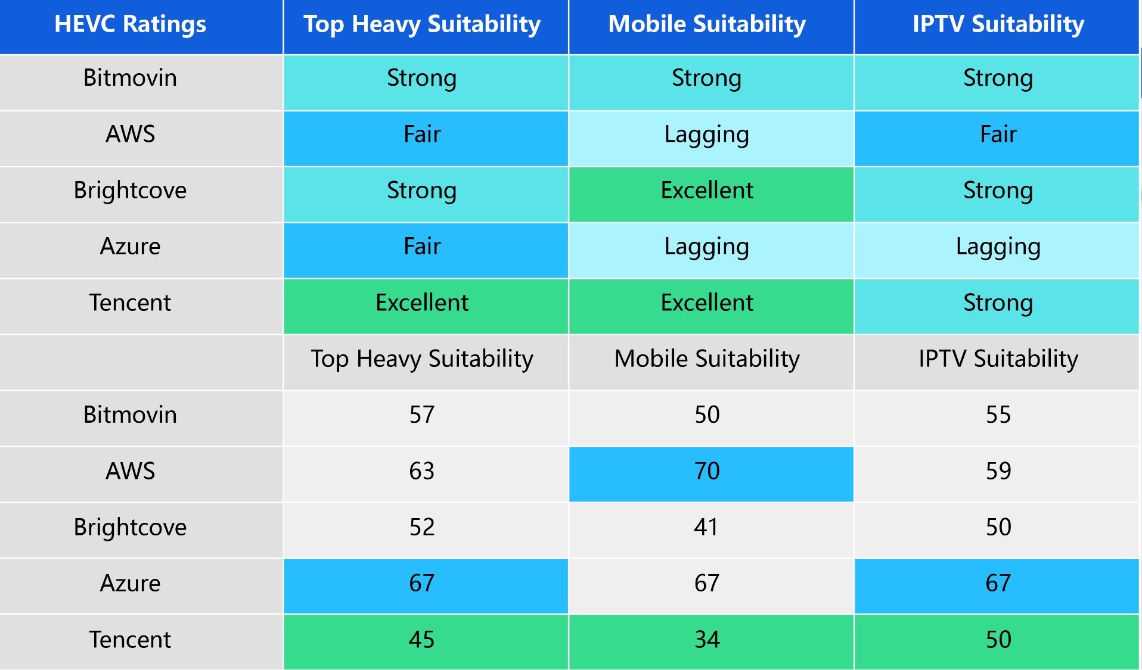
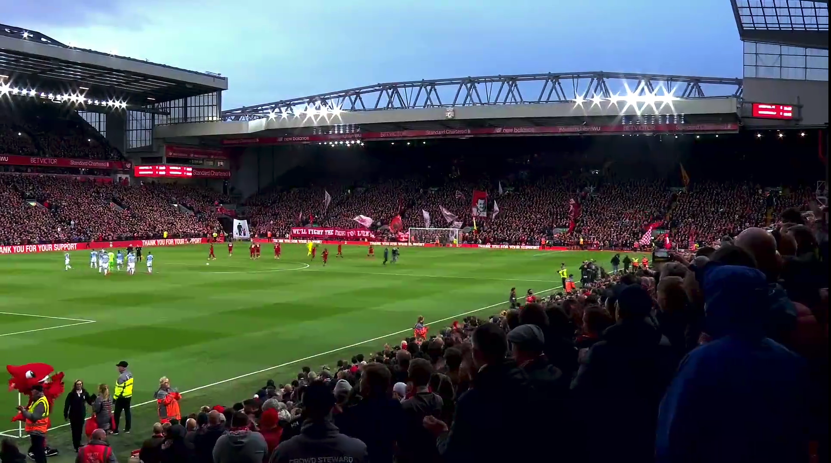
Industry-leading Video Transcoding Technology
Video Codecs
Comparison
International standard research
and development cooperation
No.1
O264、V265、VAV1
100+
H.266/VCC
TOP SPEED CODEC
Bitrates: 2.5 Mbps
50%+
20%+
Report From Streaming Learning Center (2022)
Reduction in bandwidth/storage costs
at the same subjective score
Increase in
video subjective score
at the same bitrate
H.264/AVC
H.265/HEVC
Video source
1080p | 25 FPS | 5 Mbps
TSC
1080p | 25 FPS | 2.2 Mbps
H.266/VCC
AV1
The table is provided for those that prefer numerical rankings. Lower scores are better. As with all numerical tables, green is the best score.
Notes:
This page showcases the achievements of vod transcoding technology in the industry.
The report results from streaming learning center in 2022(Streaming Learning Center, an international authoritative streaming media technology platform), vod video transcoding technology has achieved the number one ranking in h264, h265, AV1 encoding standard.
In addition, more than 100 patents have been applied to international standard research and development cooperation.
Top Speed Codec (TSC) transcoding can reduced by more than 50% bandwidth and storage costs at the same subjective score, and increase more than 20% in video subjective score at the same bitrate.

Slide 14
Core capabilities - TSC · movies compressed by 72%
Video source 5 Mbps bitrate | 1080p
Link to source video
After transcoding 1.4 Mbps bitrate | 1080p
Link to transcoded video
Notes:
Here is the demo of core capability top speed codec transcoding.
On the left is the video source file，It has 1080p resolution and 5M bit rate
and on the right, it is a video file transcoded by TSC encoding, it also has a resolution of 1080p, but the bit rate is only 1.4M
We can play and experience.
Ok，let's watch another video
We can see that there is no difference in picture quality under subjective viewing experience, but the bit rate can be reduced by more than 70%
So it can help customer save a lot of CDN and storage cost.

Slide 15
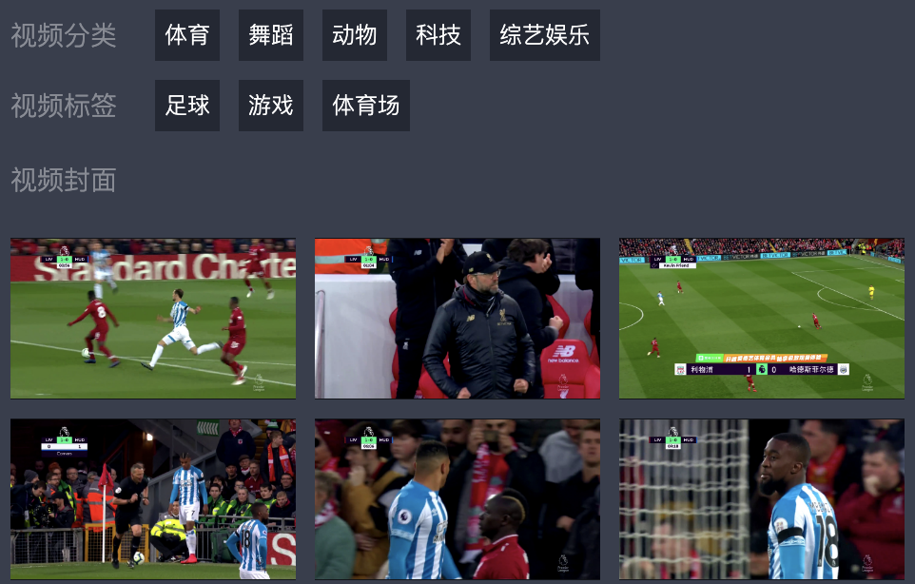
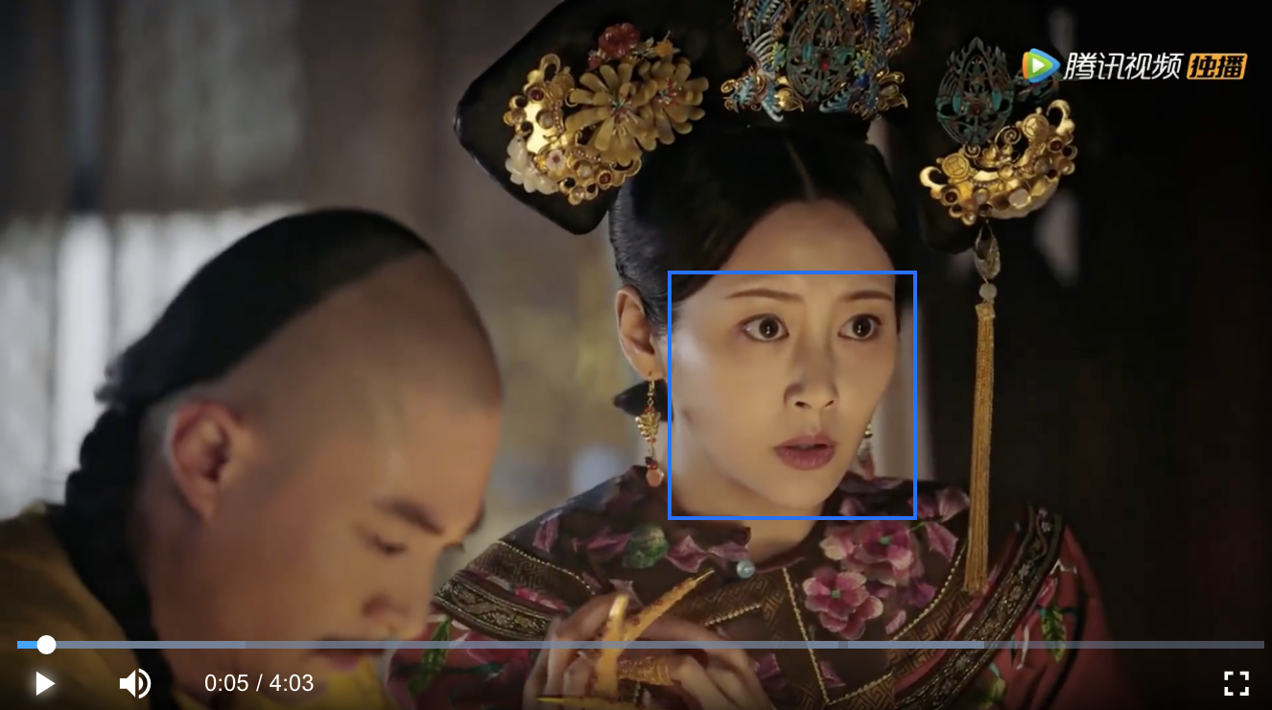
Powerful media asset intelligence
Media intelligence provides features of content audit, analysis and recognition based on AI capabilities.
Content audit, including pornographic, violent and political content check.
Content analysis: categorize, tag, and choose covers for content
Content recognition, including face, speech, text recognition.
Person Audit: Audit the persons and objects in content.
Audio Audit: Audit the sensitive content in audio.
Text Audit: Audit the text in the video.
Intelligent classification: Suggests on the category of the video, such as news, entertainment, technology, food, etc.
Intelligent tagging: Suggests on the tags of the video, including over 3000 tags.
Intelligent cover: Selects one or more screenshots from the video to use as the recommended cover.
Face recognition: Checks for particular people in video image.
Speech recognition: Checks for text and keywords in speech content.
Text recognition: Checks for sensitive words and specific keywords in video image.
Opening and closing part recognition: Marks the positions of opening part, closing part in the progress bar
Media asset intelligence provides rich feature matrix and reaches an excellent level of recoginition.
Notes:
This a another core function of vod， media asset intelligence, which provides features of content audit, analysis and recognition base on the powerful AI capabilities of Tencent Cloud
The content audit feature can help you effectively recognize non-compliant content (pornographic, violent, and political) in images, text in images, and audio.
Based on advanced speech, text, and image recognition algorithms and models, VOD’s content audit feature delivers industry-leading recognition accuracy, helping you ensure content compliance.
Content analysis ability provided can categorize, tagging and choose covers for content intelligently.
About Content recognition capability, which support face, speech, text recognition, it helps you quickly recognize faces in a video, including the frames a person appears in and the coordinates of the areas of the face. And checks for text and keywords in speech content or video image. And also support marks the position of opening part, closing part in the progress bar, which named opening and closing part recognition.

Slide 16
Comprehensive media security protection
The main forms of media asset security infringement are hotlinking, cracking and piracy
hotlinking： The playback URL is linked at other sites.
cracking： The encrypted video is cracked and spread.
piracy： Screen recording software transcription or camera shooting.
VOD fully protects media assets through anti-leech, video encryption, watermarking and DRM
Feature | Target | Description
Anti-leech | hotlinking | Identify the source through the Referer field of the playback request, and control it in a black and white list. Add control parameters to the playback link, use Key as a signature, control the link validity time, trial duration, etc.
Video encryption | cracking | Use the key to encrypt the media content, and the playback-end obtains the content key and decrypts it for playback.
Watermarking | piracy | Graphic watermarks, floating watermarks, digital watermarks, help trace the source
DRM | cracking, piracy | Support DRM protection such as Widevine, FairPlay, achieve hardware-level encryption.
Notes:
In terms of media content security， vod provides comprehensive media security protection capabilities.
In media industry, The main forms of media asset security infringement are hotlinking, cracking and piracy. Like hotlinking, the playback url is linked and played at other sites, cracking means the encrypted video is cracked and spread. And piracy is mainly reflected in screen recording software transcription or camera shooting.
Vod fully protects media assets through anti-leech, video encryption, watermarking and DRM
For each feature, like anti-leech, aims to solve the hotlink problem
For video encryption, it aims to tackles the cracking problem
For watermarking, the goal is to solve the piracy issues.
For DRM, aims to solve the cracking, piracy issues.

Slide 17
Product Architecture
VOD Product Architecture: Media Uploading, Storage, Distribution and Playback
Upload
Media Storage
Media Distribution
Playback
APP Server
Upload
signaling
Storage
Management
Access
Control
Bandwidth
Limitation
APP Client
APP Client
Information
Management
Migration
Playback
Control
Content
Control
Storage
CDN
Browser
Live Record
Video Production
Media Processing
Supporting System
Transcoding
Media AI
Quality Control
Config management
Notes:
On this page showed vod product architecture
We can understand it from the perspective of video production, upload, storage and processing, distribution, and playback.
This is somewhat similar to the product overview, we can skip it
In video production end, after video production, we can upload video by app server, app client, also can through live record to vod
For media storage phase, here you can transcode and intelligently process the video.
during media distribution， We can provide a smooth viewing experience with low latency and high reliability by Acceleration nodes all over the world
Similarly, various playback devices such as App client and browser are also supported on the playback side

Slide 18
Comparison with Other Cloud Service Providers
Fields | Tencent VOD | Ali VOD | AWS
Upload Success Rate | Over 99.5% | About 90% | About 90%
Cost-reducing Solution | One stop solution: Smart Cold Storage, Partial Deletion, TSC | None | None
Transcoding Quality | 1st Place in 2021 MSU Cloud Video Transcoding Services Comparison | Normal | Normal
AI Performance | over 95% accuracy rate of intelligent recognition, industry-leading place | Normal | Poor performance in localization recognition
Media Asset Security | High security level, effective block known plugins and tools Easy to use, fully integrating DRM in 1 hour | Low security level of private encryption | No Private Encryption Solution Need to integrate third-party DRM providers
VOD has absolute advantage over other providers in terms of quality, cost, security and features!
Notes:
As this table shows， compared with other cloud service providers
we can see Vod has absolute advantage over other providers in terms of quality, cost, security and features

Slide 19
Scenarios: Long Videos
Long videos are widely used in fields like Online Education, video platforms and OTT services.
VOD provides a one-stop solution for long video scenarios
Definition
Switch
Switch to different definitions automatically or manually in player
Reduce Cost
Smart cold storage or partial deletion for unpopular videos, reducing storage cost
Progress bar
preview
Preview key frame information on progress bar
Access Control
Use key as a signature, control the link validity time
Intelligent Subtitles
Display subtitles, which can be generated by voice recognition
Content
Encryption
Encrypt video content in case of piracy
Video Clipping
Remove opening and closing parts. Clip segments of video.
Notes:
As we all known，Long videos are widely used in fields like Online Education, video platforms and OTT services.
For this scenarios, vod provides a one-stop solution including

Slide 20
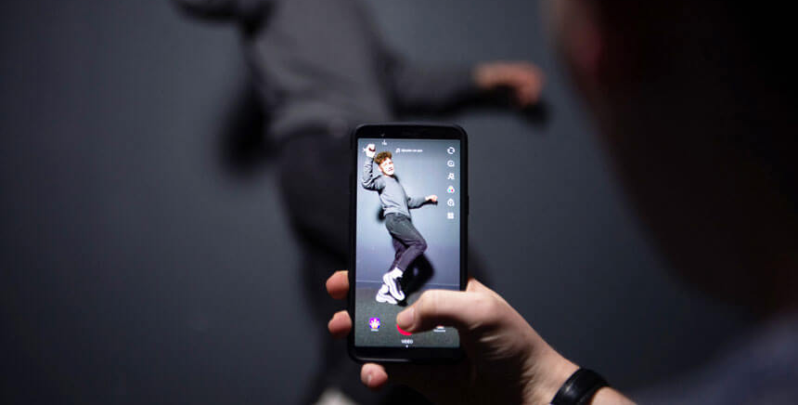
VOD Scenarios
Long Video
Short Video
Live to VOD
Online Education
Online Streaming Platforms
OTT Platforms
E-commerce
Social media
Online Education
Social media
E-commerce
Video game
VOD solutions
Storage management
Smart cold storage
Smart media processing
Intelligent Subtitles
HLS encryption
DRM
VOD solutions
UGSV SDK
QUIC upload support
Smart bitrate reduction/TCS transcoding
AI detection
Player SDK
VOD solutions
Time shifting playback
Real time clip and distribution
Live recording
Playback after livestream
Vod to live
Notes:
So, what kind of customers vod serve, we have 3 main scenarios.
Long video business, like online education and online streaming platforms, ott platforms , they have lots of media assets, and face the content piracy problem. We have smart cold storage, media processing and DRM solution for them
Short video business, like e-commerce or social media like tiktok, the content is made by users all from the world, we have ugsv sdk quic upload and TSC transcoding solutions for them
Live to VOD, almost all live streaming platforms will have playback requirements, like online education, video game platform, sports games, with time shifting playback or real time clip and live recording
And then for each scenario, I'll introduce a customer use case, help us to get some clue about how to use vod to solve customer business needs.

Slide 21
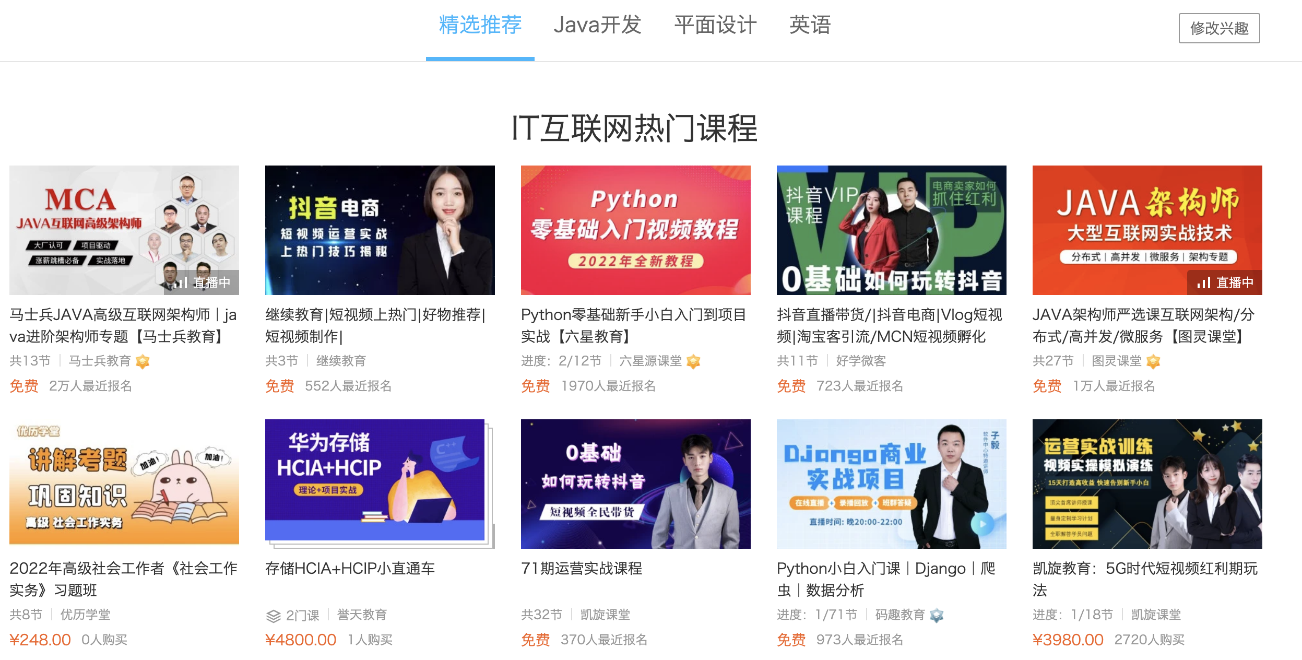
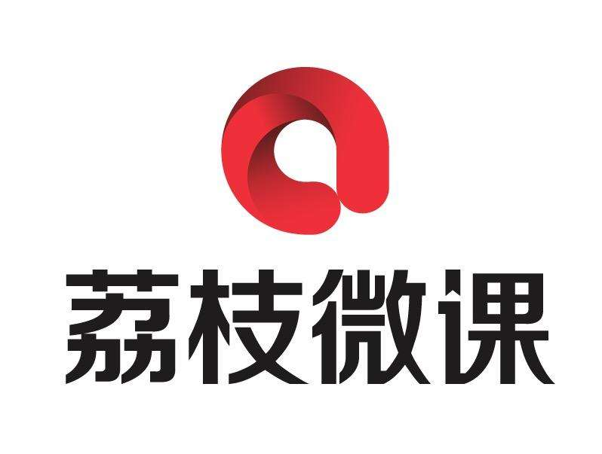
Customer Case | Online Education – Tencent Classroom
Tencent Classroom is a vocational education video platform, and the course resources come from teachers. After the teachers record the courses on the terminal, they uploads the videos through the SDK provided by VOD (the upload success rate is over 99.5%). The uploaded courses will be transcoded to adaptive stream and be encrypted. If the video becomes popular, more sub-streams will be added to improve the playback quality. Conversely, some sub-streams are deleted for unpopular videos to save storage costs.
Teacher
Terminal
Record
Teacher
Client
Upload
Content
Operation
Transcode
Content
Operation
Encryption
Content
Operation
Release
Content
Operation
Add/Delete
Sub-stream
Notes:
first use case is online education platform-tencent classroom, it is a vocational education video platform，and the course resources come from teachers
After the teachers record the course on the terminal, they will face the following challenges: upload success rate, the cost of video storage is high, and it cannot adapt to the smooth playback experience of various network environments, and it is also easy to be pirated.
These challenges can be overcome by the SDK, transcoding, security protection, smart cold and other processing capabilities provided by vod
In the end, customers not only save costs, but also provide end users with a stable and smooth viewing experience

Slide 22
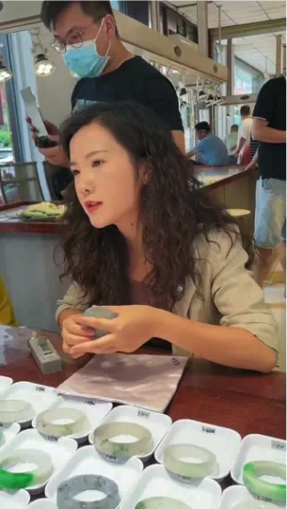
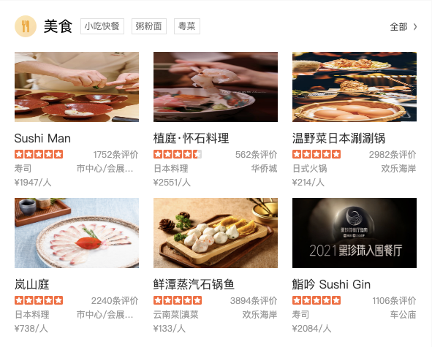
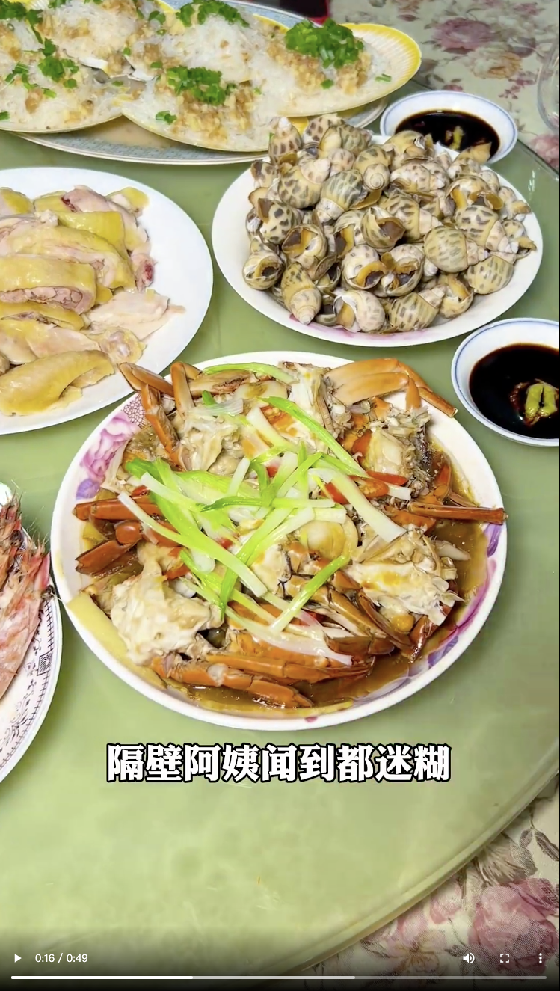
Customer Case | E-commerce - Dianping
Promotional videos of merchants and experience videos of consumers can be uploaded to VOD through the APP. Dianping takes a screenshot of the video and uses it as video cover. They can also convert video to WEBP animation, to generate dynamic cover page when previewing the homepage. At the same time, the video will be transcoded to different resolutions using TSC, so as to achieve high-quality and low-bit rate during distribution.
Merchants
Consumers
Video
Production
Animtion Cover
TSC
Static Cover
Merchants
Consumers
Upload
Content
Operation
TSC
Content
Operation
Convert to
Animation
Content
Operation
Audit
Content
Operation
Release
Notes:
The second use case is E-commerce-Dianping, a China's top e-commerce platform.
Promotional videos of merchants and experience videos of consumers can be uploaded to VOD through the APP
Their needs are screenshots, making animations cover and high-definition low-bitrate
With the help of VOD media processing, top speed codec, smart auditing capabilities, Dianping takes a screenshot of the video and uses it as video cover easly. They can also convert video to WEBP animation effectively.
At the same time, the video will be transcoded to different resolutions using TSC, so as to achieve high-quality and low-bit rate during distribution, and saving a lots of CDN cost.

Slide 23
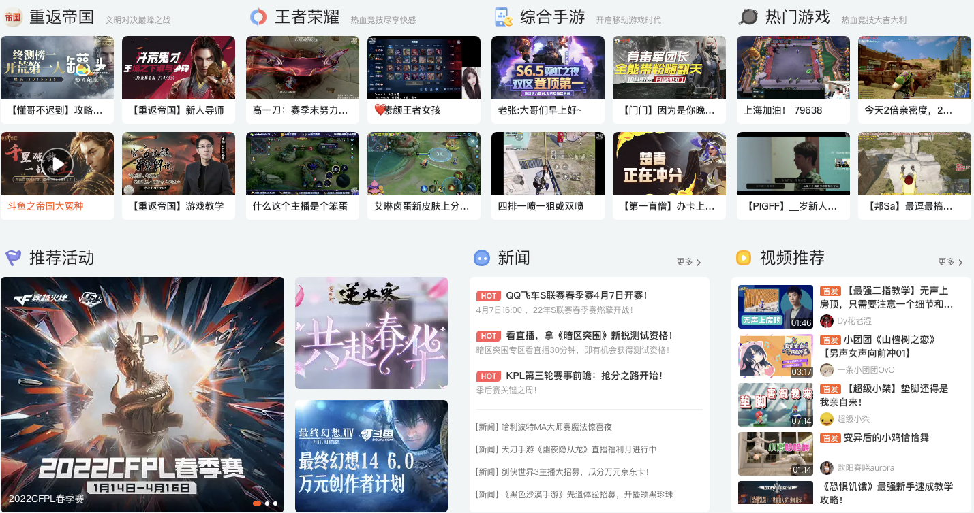
Customer Case | Live Streaming - Douyu
Game host or event operator will record the live streaming to VOD, and then initiate transcoding of different resolutions, and generate screenshots at the same time. Douyu's operators will judge whether the video is compliant based on the screenshot, and publish the video for distribution and playback VOD.
Game Host
Live Streaming
Game Host
Live Record
Content
Operation
Transcode
Content
Operation
Screenshot
Content
Operation
Audition
Content
Operation
Release
Notes:
The last use case is Live streaming-Douyu, a Larger game live streaming platform in China.
Game host or event operator will record the live streaming to VOD, then the platform needs multi-resolution transcoding, smart screenshots, and content audit capabilities.
Live recording to vod through cloud live streaming, and transcoding, media processing such as screenshot, clipping, and smart audit capabilities provided by vod douyu can judge whether the video is compliant based on the screenshot effectively and distribution these videos with a lower cost.

Slide 24
Thanks

